Slide 1

CNN DETECTION ON GPU
CUDA C IMPLEMENTATION

Slide 2
Agenda
01
02
03
CUDA C software
Matrix multiplication algorithm
GPU Introduction
Introducing GPU hardware and functionality. Explaining threads, blocks inside a grid, warp of threads and streaming multiprocessors
Introducing CUDA kernels and algorithms used to implement the CNN
Get a modern PowerPoint Presentation that is beautifully designed. Easy to change colors.
04
05
06
GEMM algorithm
Reduction algorithm
Results
Implementation of a convolutional layer using GEMM algorithm.
Implementation of a mean kernel by calculating all elements of the array
Comparing implemented CUDA model vs python high level model CPU and GPU runtime.

Slide 3
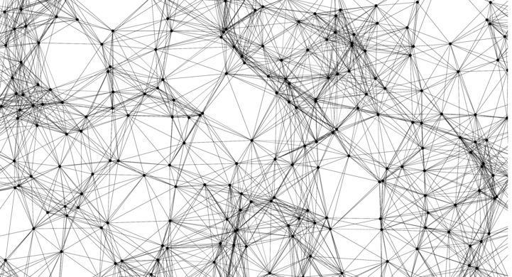

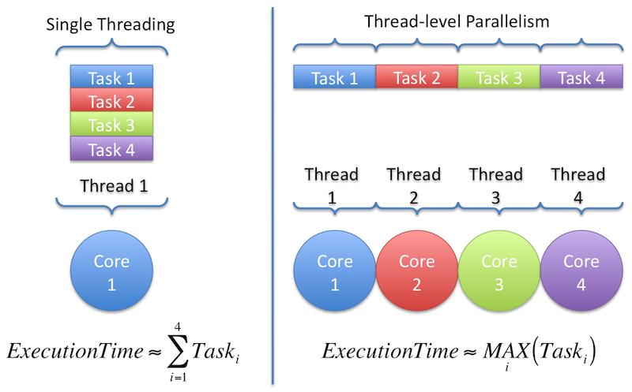
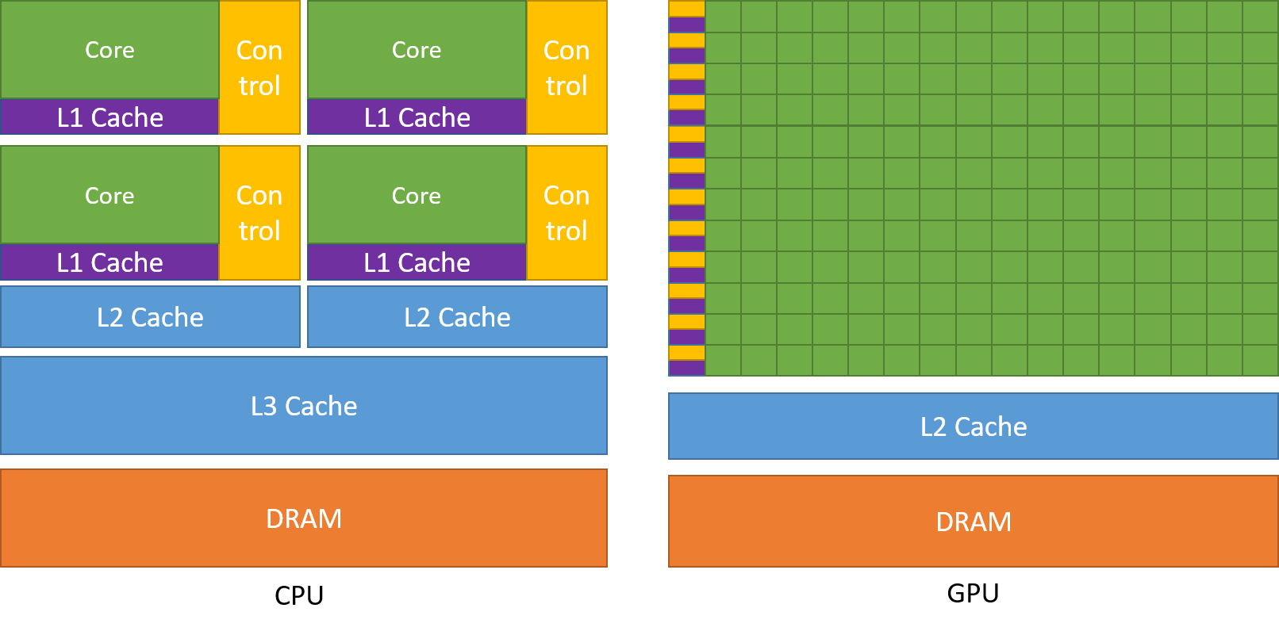
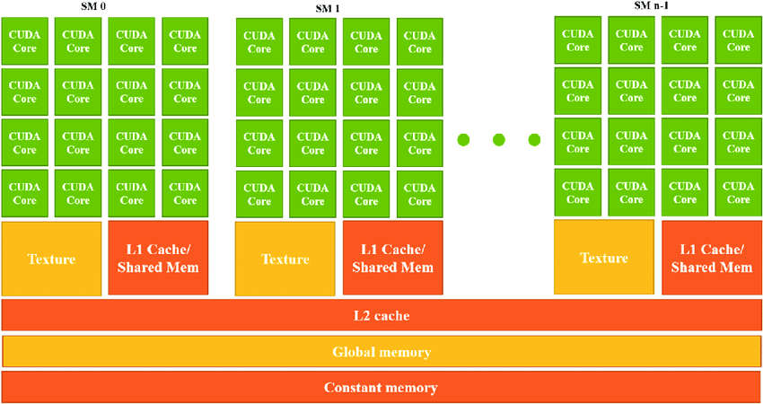
GPU Introduction
CPU architecture contains limited number of cores which gives a limit on the available parallelism .
GPU is designed to execute thousands of threads in parallel.
3

Slide 4
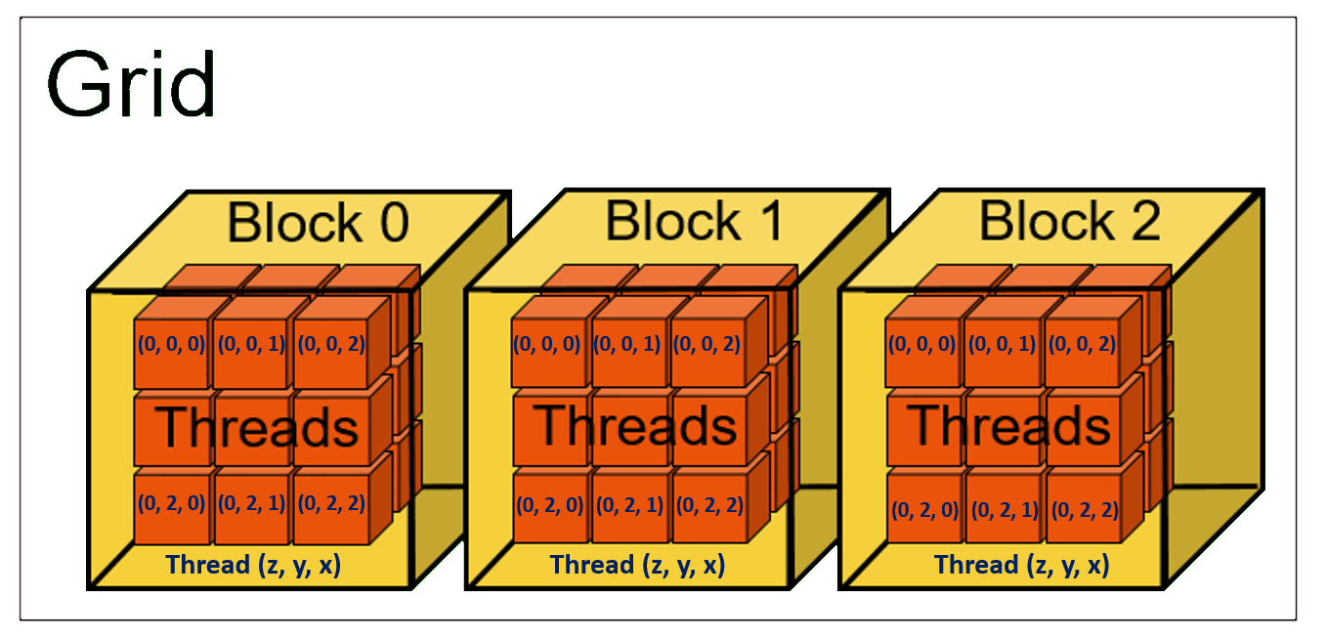
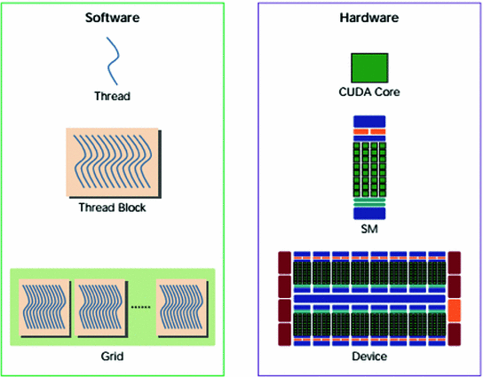
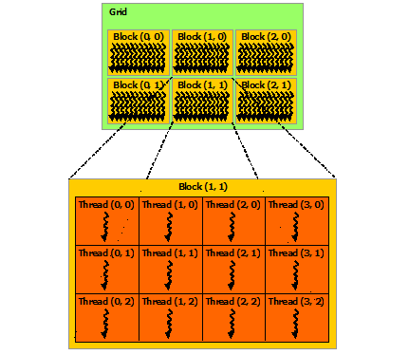
GPU Introduction
Maximum number of threads per block is
1024, they share a limited memory resource
Z direction
X direction
Y direction
Thread Blocks execute independently,
they can execute in any order either
parallel or sequentially.

Slide 5
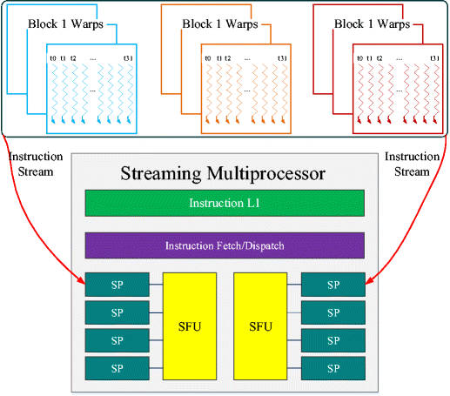
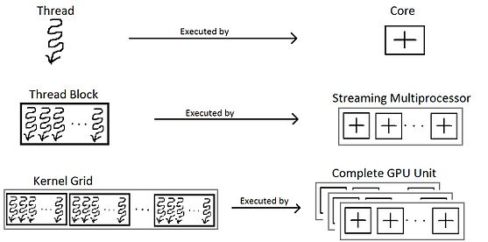
GPU Introduction
Multiple thread blocks are allowed to run on a single streaming multiprocessor.
A warp is defined to contain 32 threads and all threads in a warp execute at the same time.
These threads will apply the same instruction to different portions of the data.

Slide 6
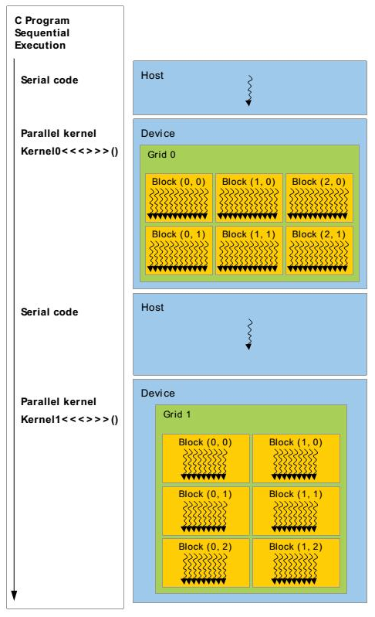
CUDA model
A function in the programming model is called a kernel,
when a kernel is called it's executed N times in parallel
by N different CUDA threads.
A kernel is defined using __global__ syntax

Slide 7
Algorithms
MATRIX MULTIPLICATION, GEMM, REDUCTION SUM
Notes:
© Copyright PresentationGO.com – The free PowerPoint and Google Slides template library

Slide 8
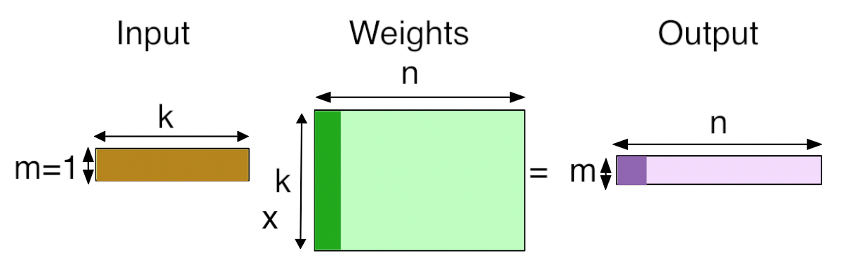
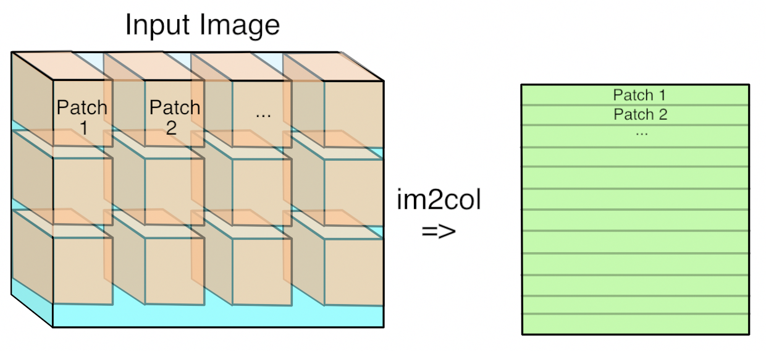
Algorithms - GEMM
GEMM algorithm reduces convolution Operation to a matrix multiplication logic.
It contains 2 unrolling operations, input unrolling and filter unrolling.
Input unrolling is known as img2col algorithm where each input feature expands in memory.

Slide 9
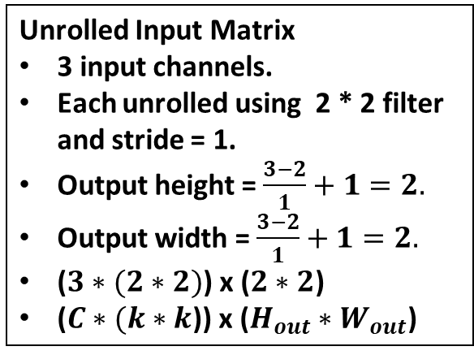
GEMM – Input unrolling
1 2 0
1 1 3
0 2 2
0 2 1
0 3 2
1 1 0
1 2 1
0 1 3
3 3 2
1
2
1
1
2
0
1
3
1
1
0
2
1
3
2
2
Input channels = 3
0
2
0
3
2
1
3
2
0
3
1
1
3
2
1
0
Unrolled Input Matrix
3 input channels.
Each unrolled using 2 * 2 filter and stride = 1.
Output height = $\frac{3−2}{1}+1=2.$
Output width = $\frac{3−2}{1}+1=2.$
($3∗(2∗2)$) x ($2∗2$)
($C∗(k∗k$)) x ($H_{out}∗W_{out}$)
1 2
1 1
1
2
0
1
2
1
1
3
0
1
3
3
1
3
3
2
1 Filter bank

Slide 10
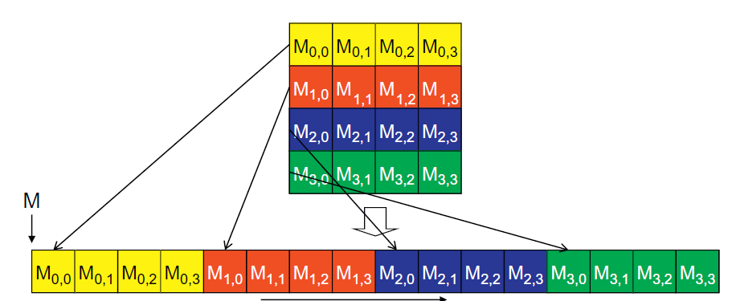
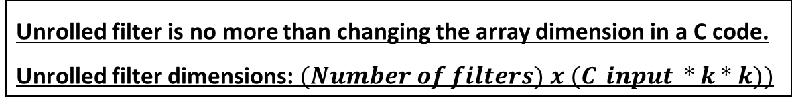
GEMM – Filter Unrolling
1 2
1 1
1 1
1 1
0 1
1 0
0 6
5 10
2 8
3 0
2 9
11 5
Filter #1
Filter #2
2 1 1 1 1 1 1 0 1 1 0
0 6 5 10 2 8 3 0 2 9 11 5
Unrolled filter is no more than changing the array dimension in a C code.
Unrolled filter dimensions: $(Number of filters) x (C_input ∗ k ∗ k))$

Slide 11
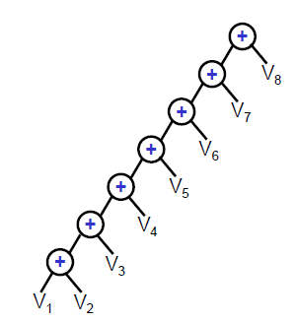
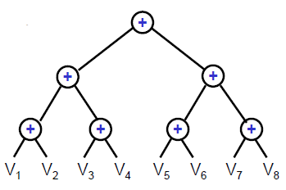
Reduction – Sum algorithm
Reduction algorithm is important for summing all elements in an array.
This operation is important as the mean value is needed in squeeze and excitation layer.
Efficient implementation is needed as this layer is repeated in the network, so it’s a bottleneck and needs a work efficient algorithm

Slide 12
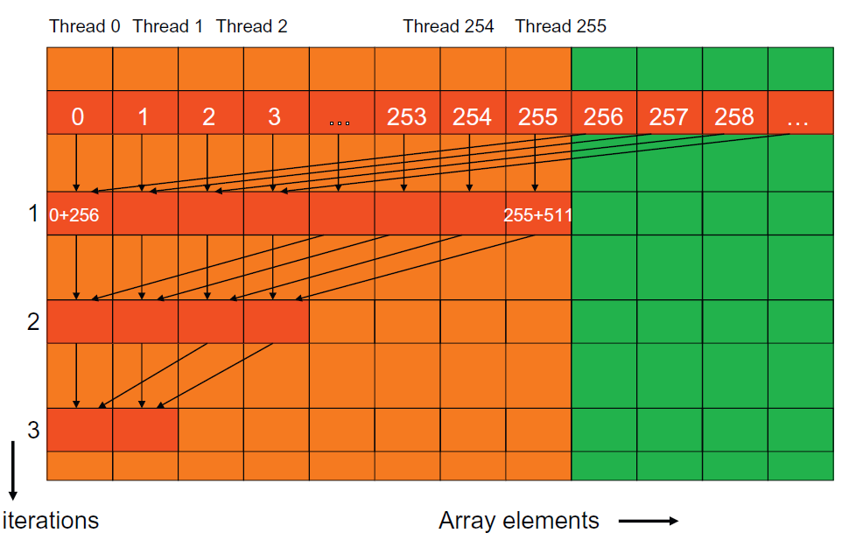
Reduction – Sum algorithm
1 thread loads 2 elements in shared memory, so we can process double the block size in a single kernel call.
Strided access is used to enhance the performance and avoid thread divergence.
For extremely large arrays, we can launch the kernel again from the host

Slide 13
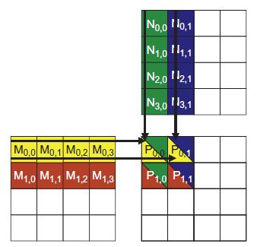
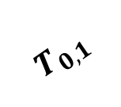
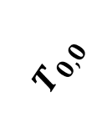
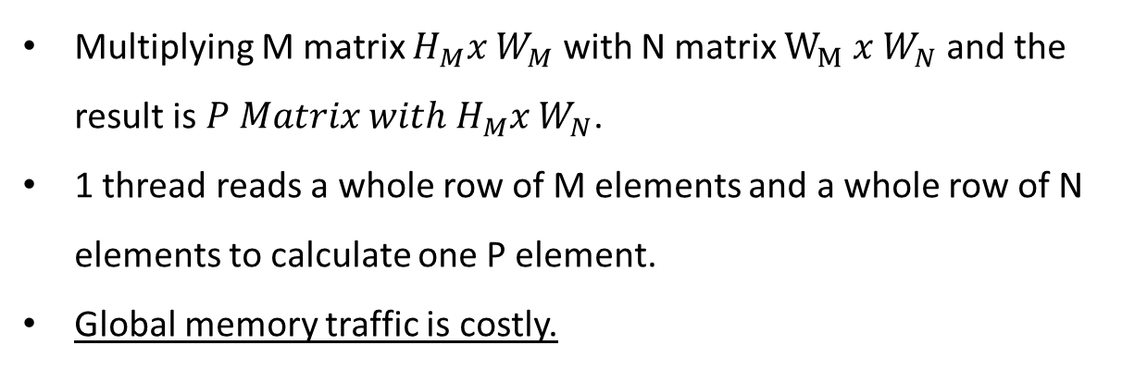
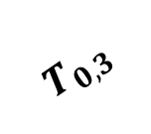
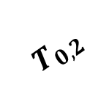
Matrix multiplication
Multiplying M matrix $H_{M}x W_{M}$ with N matrix $W_{M} x W_{N}$ and the result is $P Matrix with H_{M}x W_{N}$.
1 thread reads a whole row of M elements and a whole row of N elements to calculate one P element.
Global memory traffic is costly.
X direction
$$T_{0,0}$$
$$T_{0,1}$$
$$T_{0,2}$$
$$T_{0,3}$$
Y direction

Slide 14
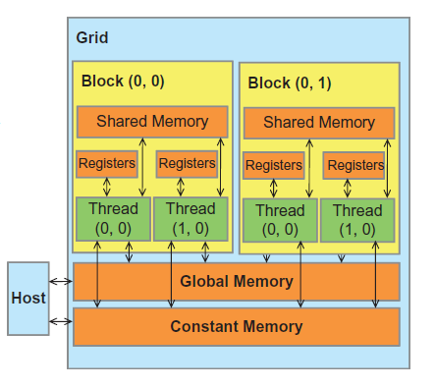
Matrix multiplication
Tile to the rescue.
In the context of parallel computing, tiling is a program transformation technique that localizes the memory locations accessed among threads.
It divides the long access sequences of each thread into phases.
The Global Memory is off the processor chip and is implemented with DRAM technology, which implies long access latencies and relatively low access bandwidths.
The Register File is on the processor chip, which implies very short access latency and drastically higher access bandwidth compared with the global memory.

Slide 15
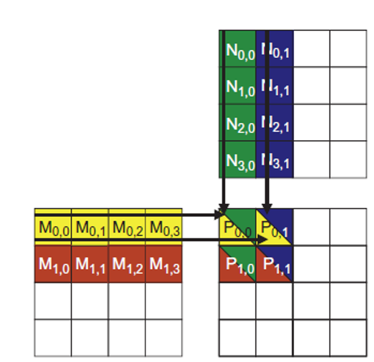
Matrix multiplication
By using 4 blocks each of 2x2 threads, we need 2 phases to complete the multiplication process.
At the beginning of Phase 1, the four threads of block0,0 collaboratively load a tile of M and N into a shared memory.
At the beginning of Phase 2, the four threads of block0,0 collaboratively load a tile of M and N into a shared memory.

Slide 16
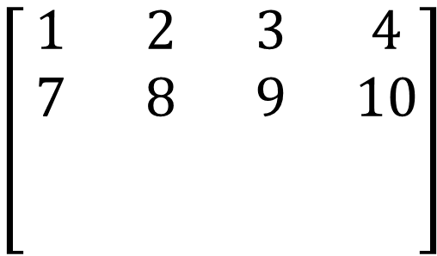
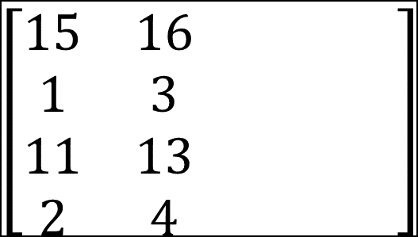


In phase #2:
1st step: All threads load certain elements different from the elements loaded from phase #1
2nd step: Multiplication accumulates and get the other partial multiplication output.
The result is that we have a final output element by the end of the 2nd phase
${Partial}_{0}$ + 3*11 + 4*2 = $Final output_{0}$
${Partial}_{1}$ + 3*13 + 4*4 = $Final output_{1}$
${Partial}_{2}$ + 9*11 + 10*2 = $Final output_{2}$
${Partial}_{3}$ + 9*13 + 10*4 = $Final output_{4}$
In phase #1:
1st step:
All threads collaborate to load certain elements from
both matrices.
2nd step:
threads calculate the partial multiplication output
1*15 + 2*1 = ${Partial}_{0}$
1*16 + 2*3 = ${Partial}_{1}$
7*15 + 8*1 = ${Partial}_{2}$
7*16 + 8*3 = ${Partial}_{3}$
$$\left[\begin{matrix}15 & 16 & & \\ 1 & 3 & & \\ 11 & 13 & & \\ 2 & 4 & & \end{matrix}\right]$$
$$\left[\begin{matrix}1 & 2 & 3 & 4 \\ 7 & 8 & 9 & 10 \\ & & & \\ & & & \end{matrix}\right]$$
N matrix
M matrix
Elements loaded and calculated in Phase #1
Elements loaded and calculated in Phase #2

Slide 17
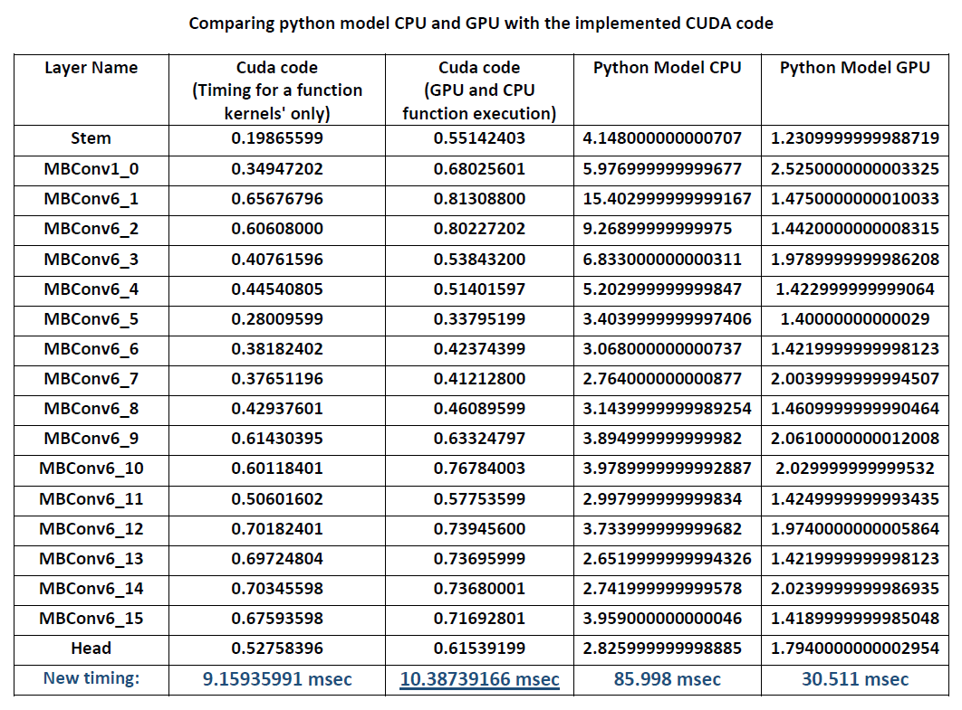
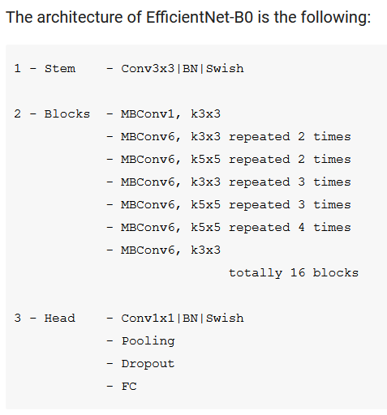
Results
Padding kernel : 0 . 020188 msec
Input unrolling kernel : 0 . 02089600
Matrix multiplication kernel : 0 . 1259040
BatchNorm equation kernel : 0 . 098552163265
ElementWise Multiplication : 0 . 012348
DepthWise Convolution : 0 . 03929
Reduction mean : 0 . 0461044
Identity skip : 0 . 00735288

Slide 18
Reference
[1] CUDA C++ Programming Guide. http://docs.nvidia.com/cuda/cuda-c-programming-guide/index.html.
[2] Cook, S., 2012. CUDA programming: a developer's guide to parallel computing with GPUs. Newnes.
[3] Udacity introduction to parallel programming
https://youtube.com/playlist?list=PLAwxTw4SYaPnFKojVQrmyOGFCqHTxfdv2
[4] Anderson, A., Vasudevan, A., Keane, C. and Gregg, D., 2017. Low-memory gemm-based convolution
algorithms for deep neural networks. arXiv preprint arXiv:1709.03395.
[5] Chellapilla, K., Puri, S., & Simard, P. (2006). High performance convolutional neural networks for document processing. < https://hal.archives-ouvertes.fr/inria-00112631/document >.
[6] Warden, Pete. "Why GEMM Is at the Heart of Deep Learning". Pete Warden's Blog, April 20, 2015, https://petewarden.com/2015/04/20/why-gemm-is-at-the-heart-of-deep-learning/.
[7] Kirk, D.B. and Wen-Mei, W.H., 2016. Programming massively parallel processors: a hands-on approach. Morgan kaufmann.

